Slide 1
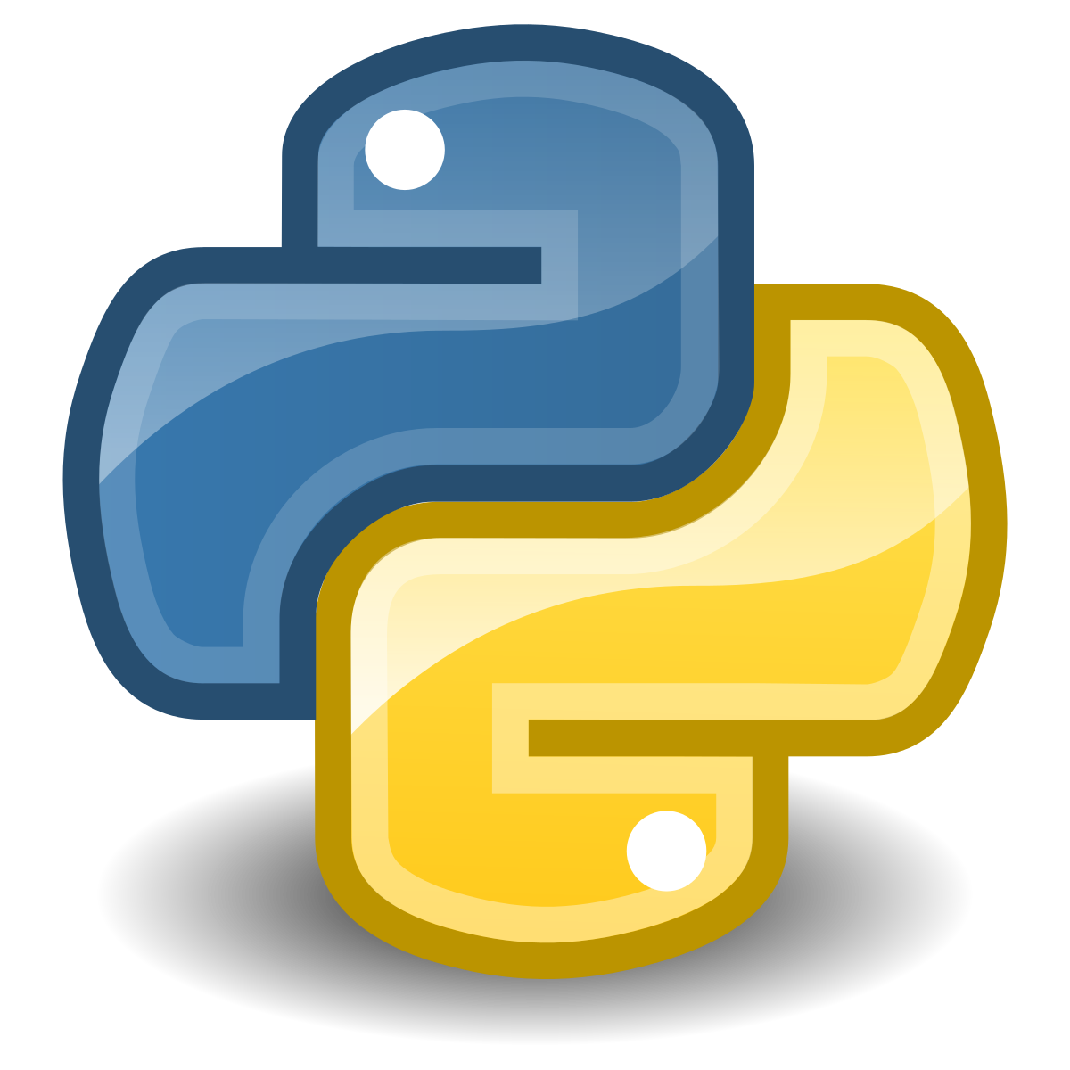
Introduction to programming with Python
Master in Big Data Solutions 2020-2021
Sergio Gago – Guillermo Alonso
sergiogh@gmail.com

Slide 2
Session 1b - Objective
Understand what is a computer, its parts and how it works
Understand why it matters
Brief history of computation
Understand the basics of Operating Systems, commands, etc.
How computers talk: Networking

Slide 3
Contents
A Computer
Brief history of computation: From Turing to Quantum
Understanding Binary Code
Operating Systems, filesystems
Networking basics: TCP/IP layer, IP Address, DNS
Hosting basics

Slide 4
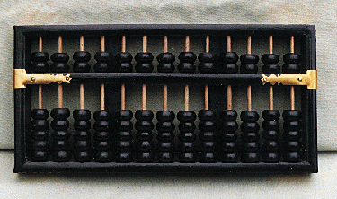
Computer Origins
Earliest computing device recognised:
Abacus
Babylonia (now Iraq) over 5000 years ago
Hand Operated calculator
Add/subtract and store current calculation (like HDD)
Computer word origin: Person who calculates

Slide 5
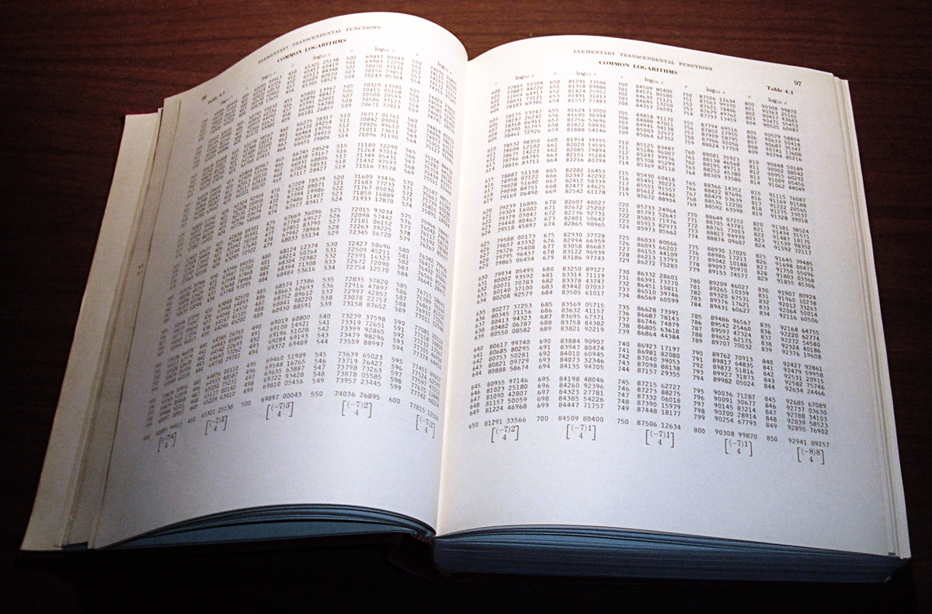
Computer Origins
Pre-Computation:
1800 to understand how cannons should be set based on conditions (air, temperature, pressure)

Slide 6
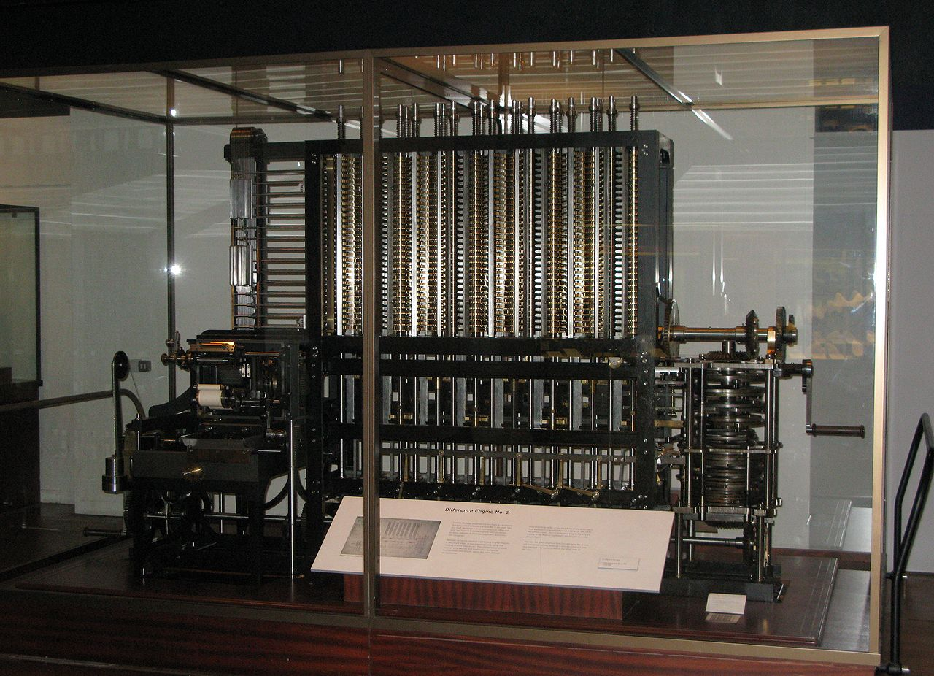
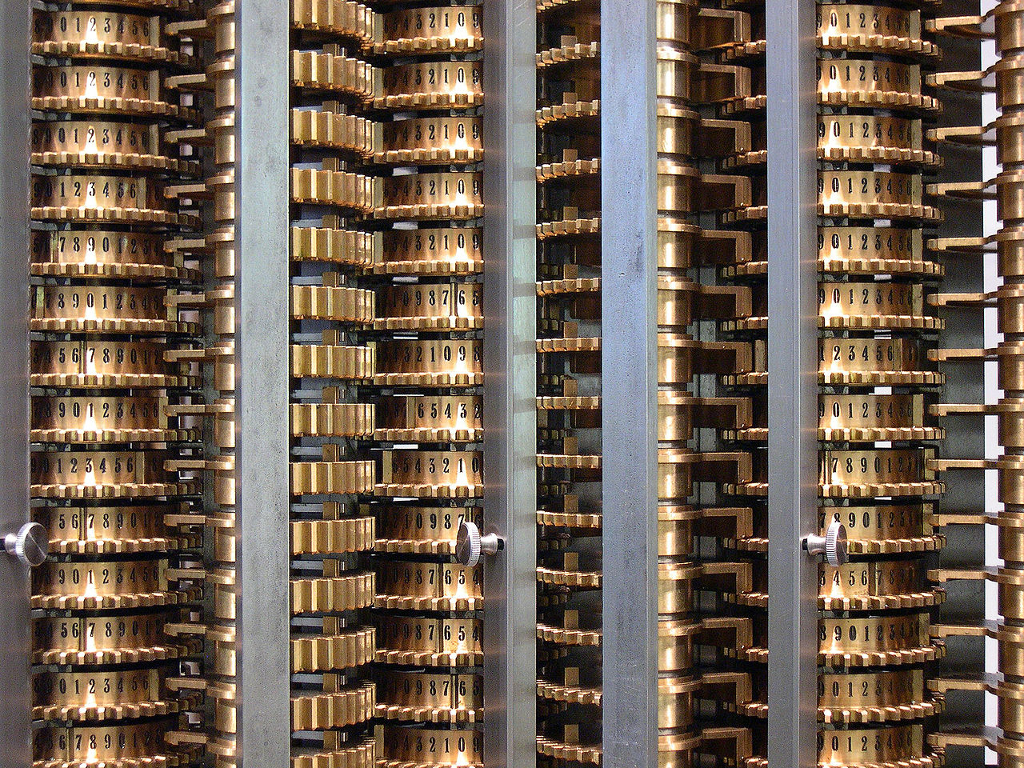
Computer Origins
Difference Engine:
First created by Charles Babbage
Automatic mechanical calculator designed to tabulate polynomial functions
Modifying gears new calculations

Slide 7
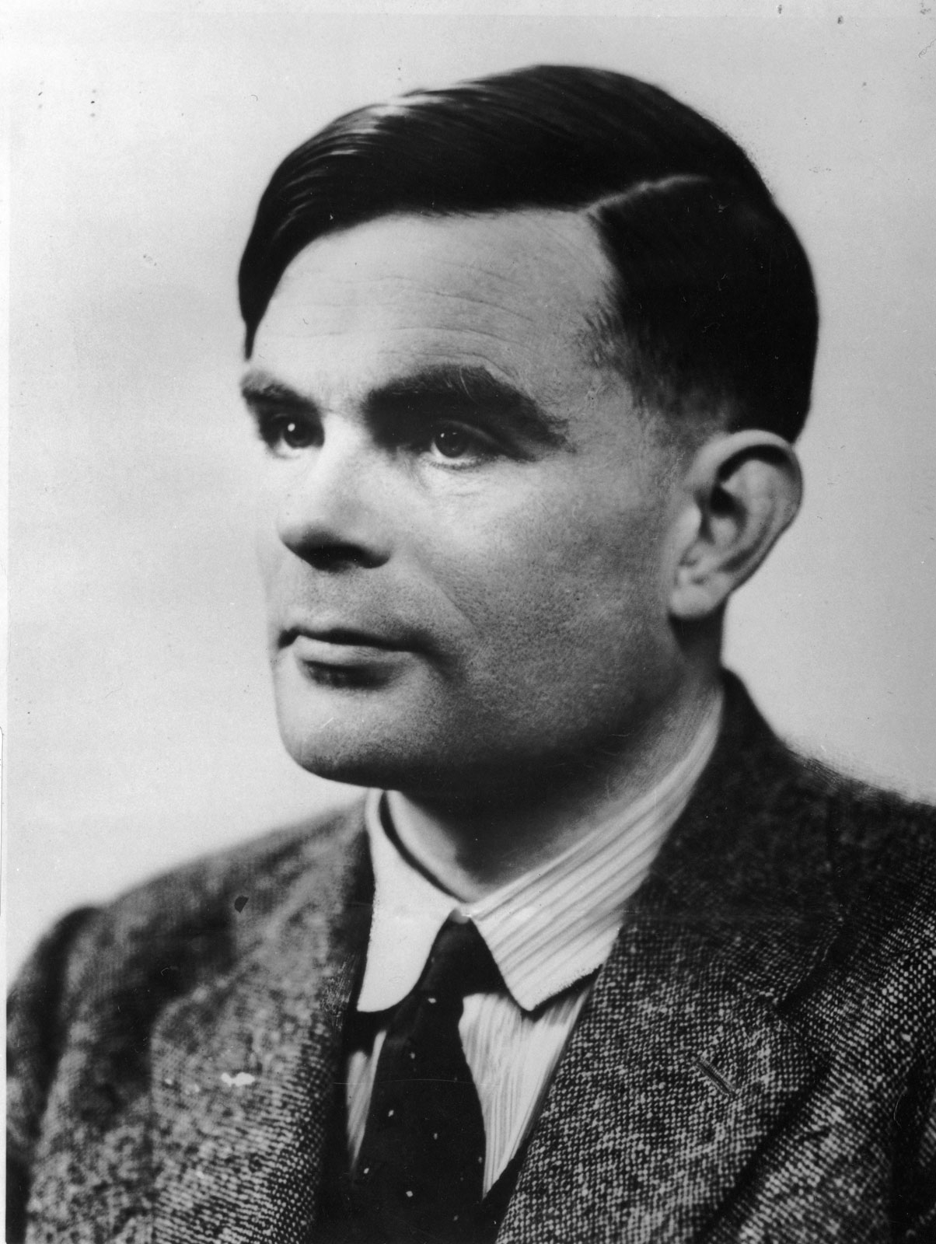
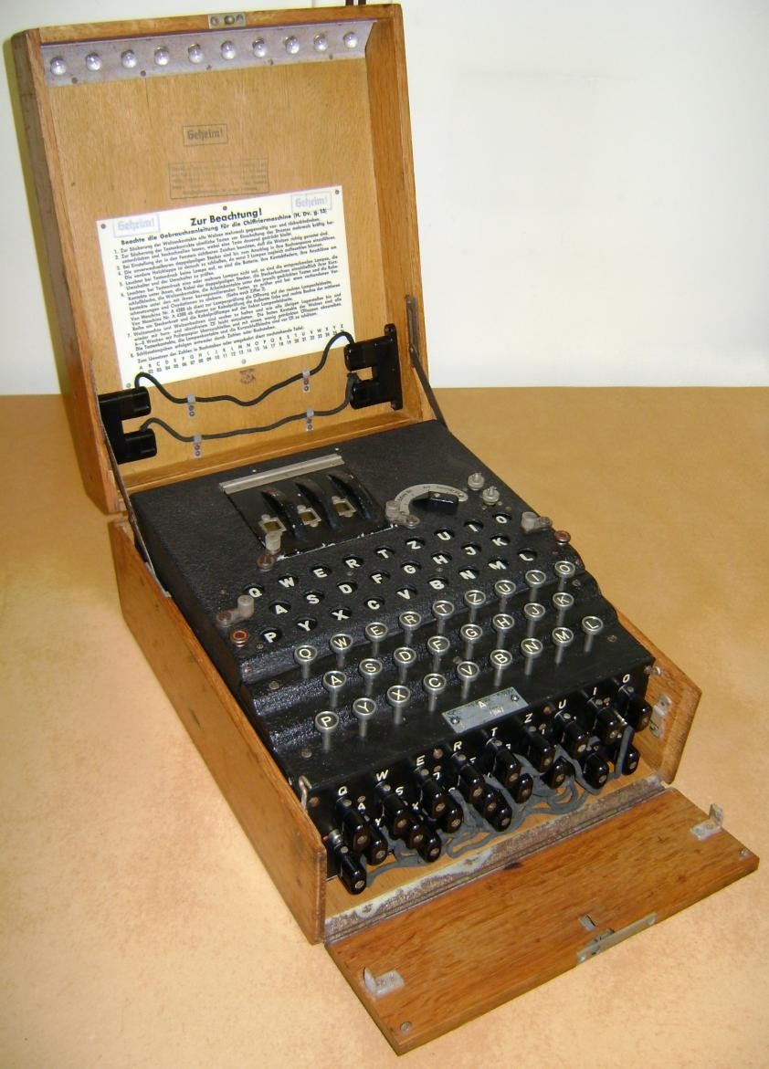
To watch: The imitation game
This Photo by Unknown Author is licensed under CC BY-SA

Slide 8
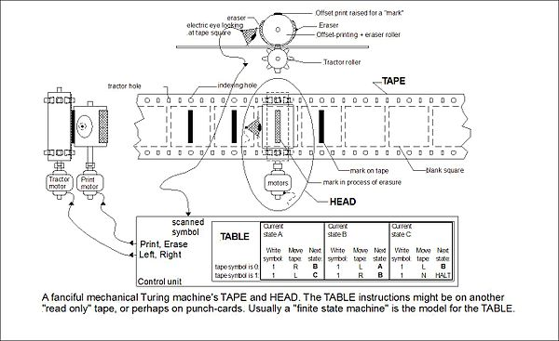

Slide 9
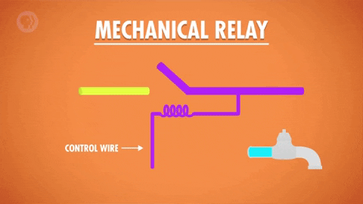
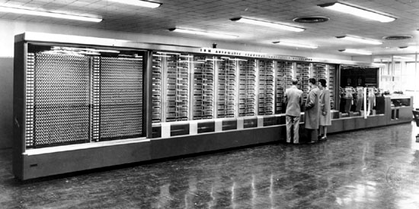
Computer Origins
The 1944 Mark I by IBM.
Built from switches, relays, rotating shafts, and clutches.
It used 765,000 components and hundreds of miles of wire
It weighed about 9,445 pounds
Good relay 50 times per second
Mark I:
3 Additions or subtractions per second
Multiplications 6 seconds
Divisions 15 seconds

Slide 10
What is a computer?
There are many definitions:
A computer is a machine that can be instructed to carry out sequences of arithmetic or logical operations automatically via computer programming
an electronic device for storing and processing data, typically in binary form, according to instructions given to it in a variable program.
A computer is a machine that accepts data as input, processes that data using programs, and outputs the processed data.
All of them contain:
Input
Process
Output

Slide 11
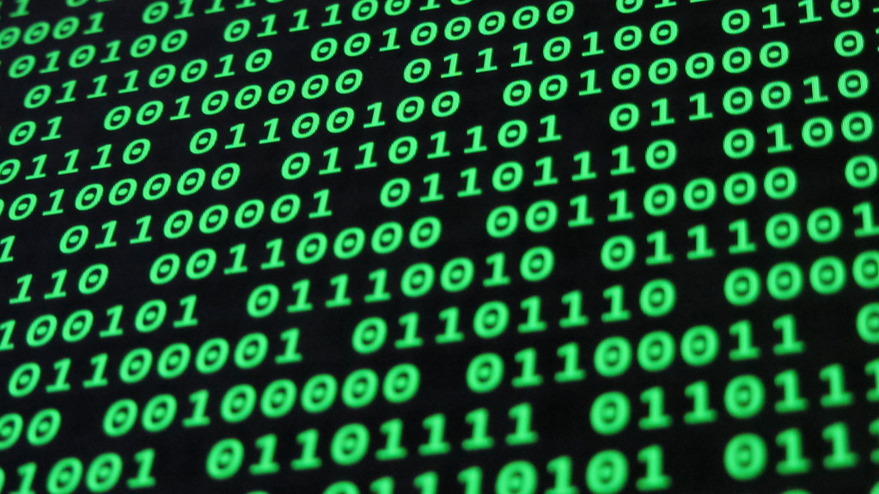
Binary Code

Slide 12
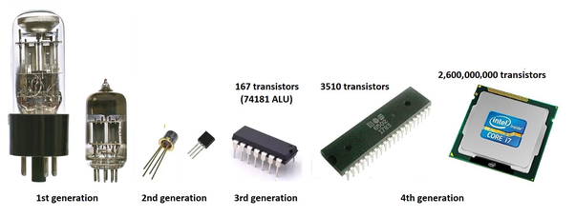
Transistors

Slide 13
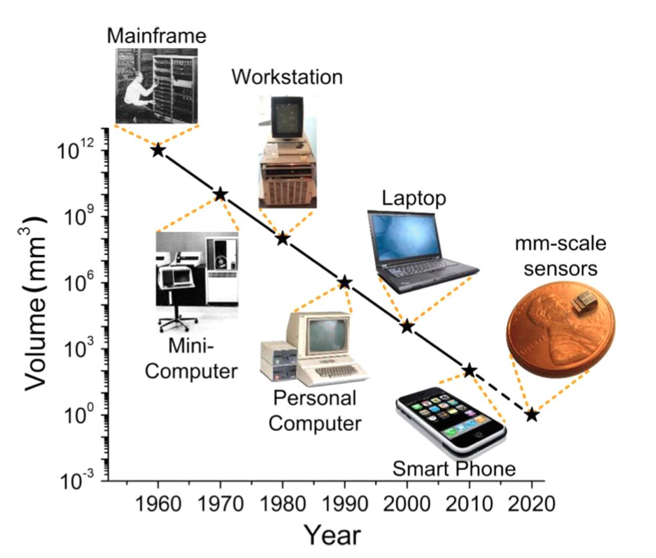
All the way to

Slide 14
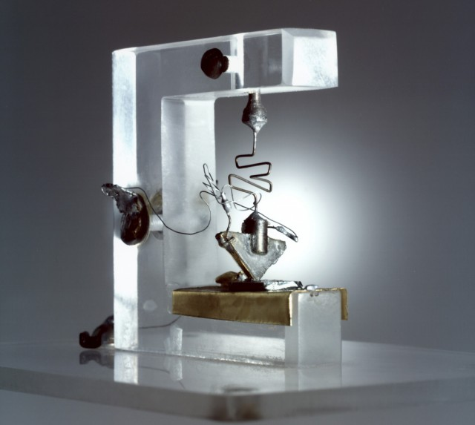
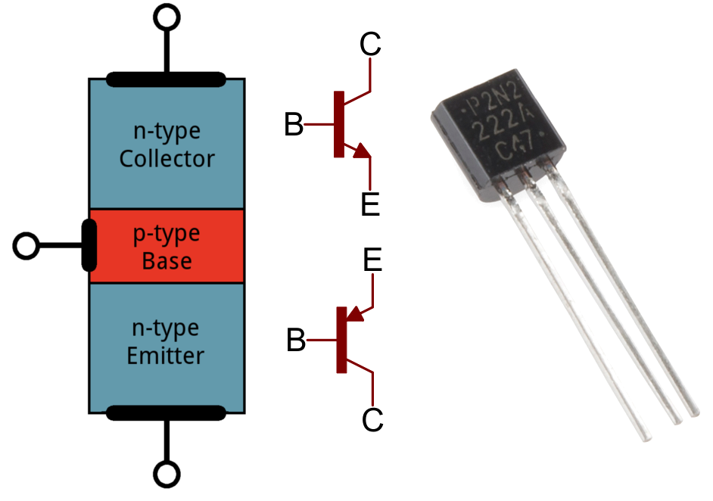
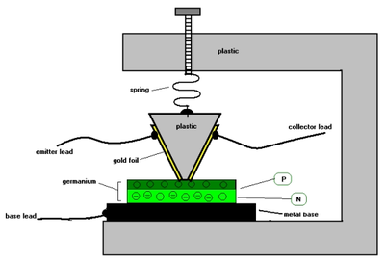
Computer Origins
Transistors (Bell labs 1947)
Use semiconductor materials
Based on the conditions of the control flow the semiconductor will allow electricity to flow or not

Slide 15
Computer Origins
Current transistors size around 50 nanometers
Sheet of paper thickness around 100,000 nanometers
They can switch state millions of times per second
Can run for decades
The most common semiconductor used is Silicon
Research and advancement happened at California
The region started to be called Silicon Valley

Slide 16
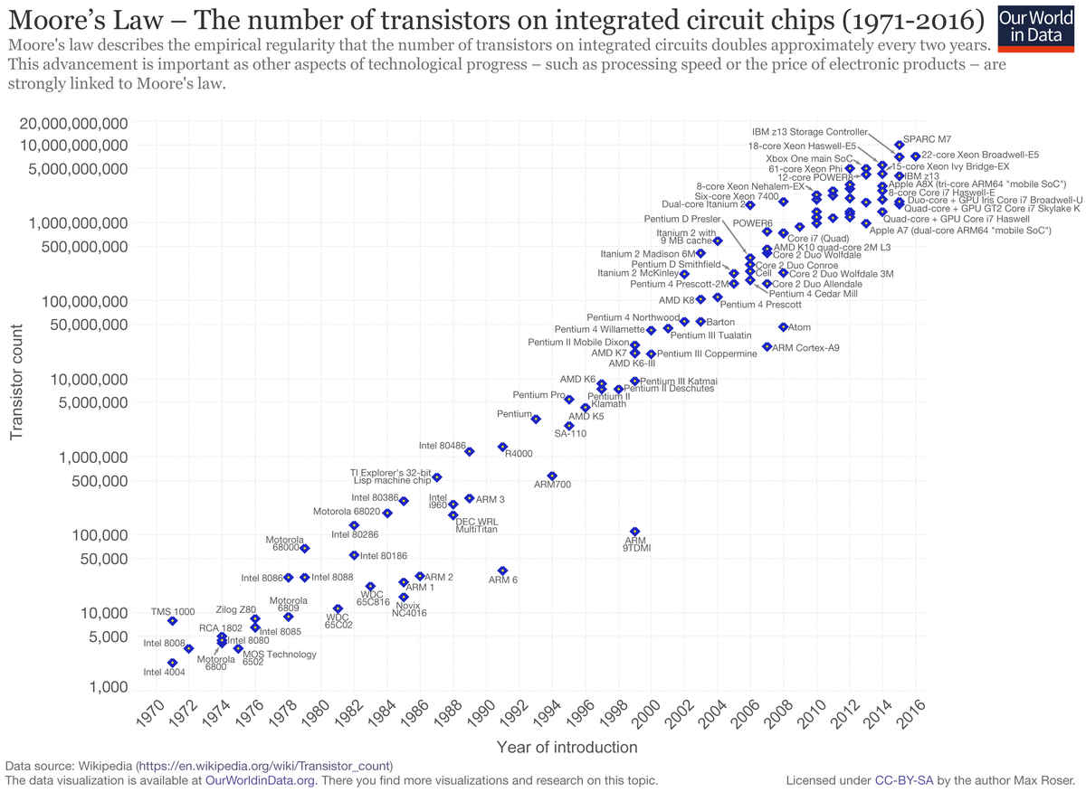
This Photo by Unknown Author is licensed under CC BY-SA

Slide 17
Binary
Two states
True / False
1 / 0
On / Off
Electricity Flowing / No Electricity Flowing
Other systems allow more states but noise makes difficult to understand the values
Mathematics Boolean Algebra already existed
https://en.wikipedia.org/wiki/Boolean_algebra

Slide 18
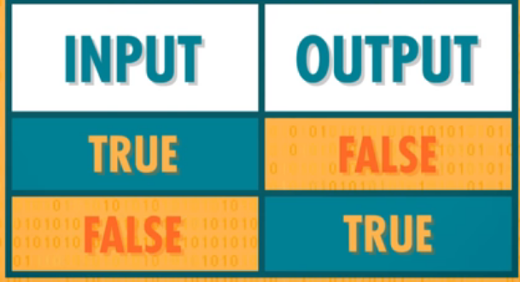
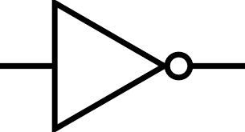
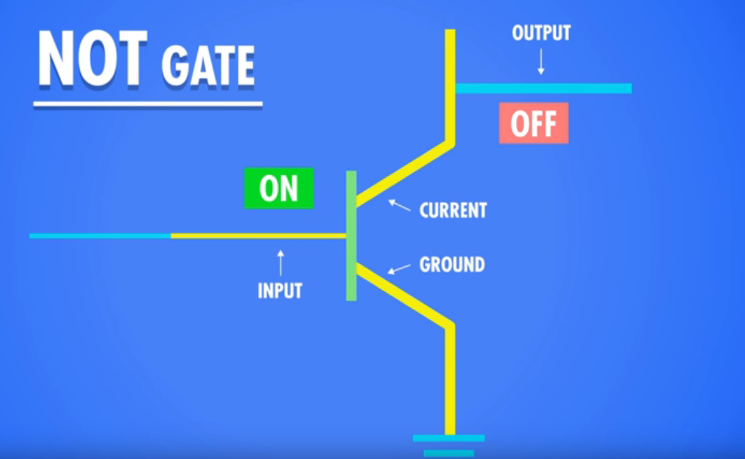
Binary
Three basic Operations
NOT

Slide 19
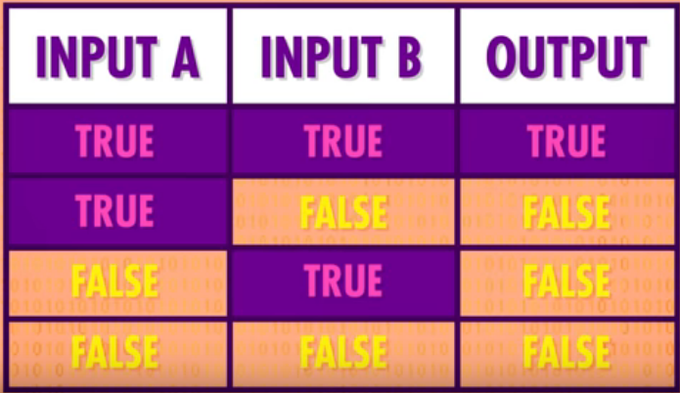
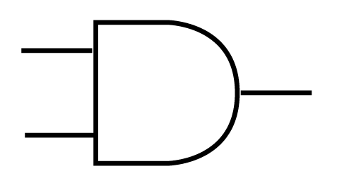
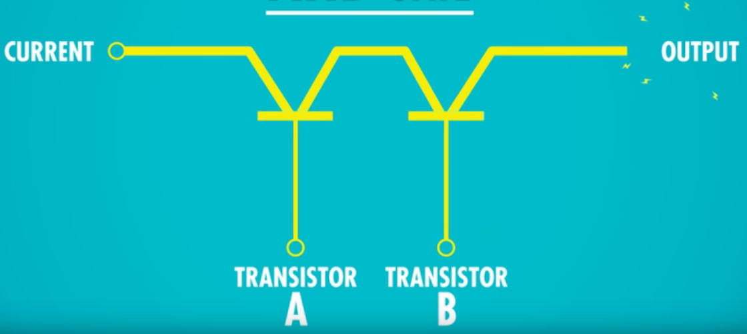
Binary
Three basic Operations
AND

Slide 20
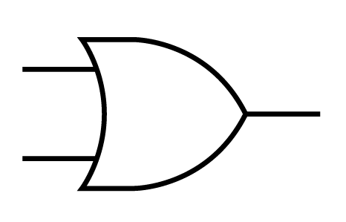
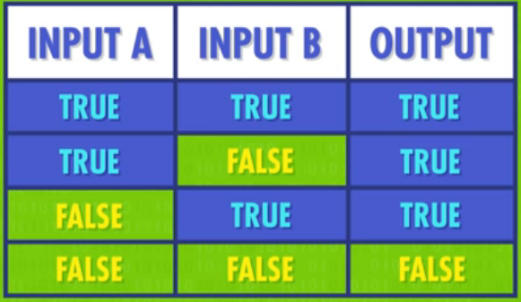
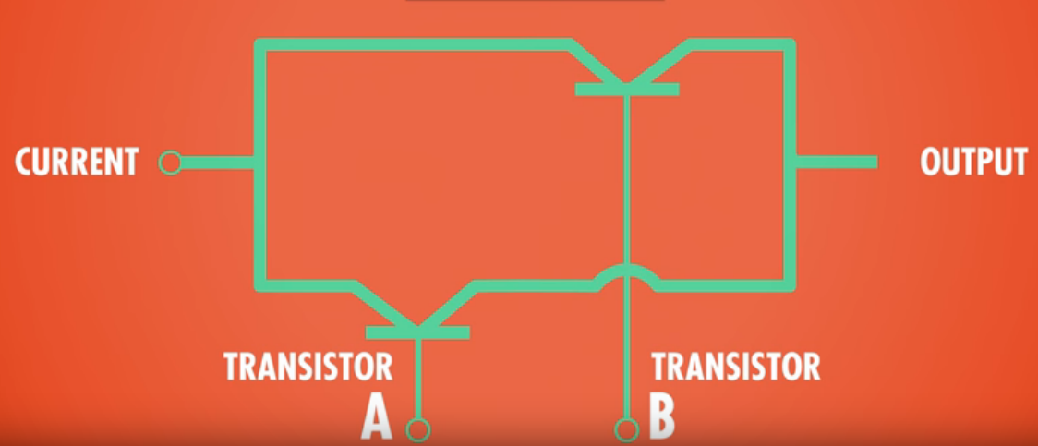
Binary
Three basic Operations
OR

Slide 21

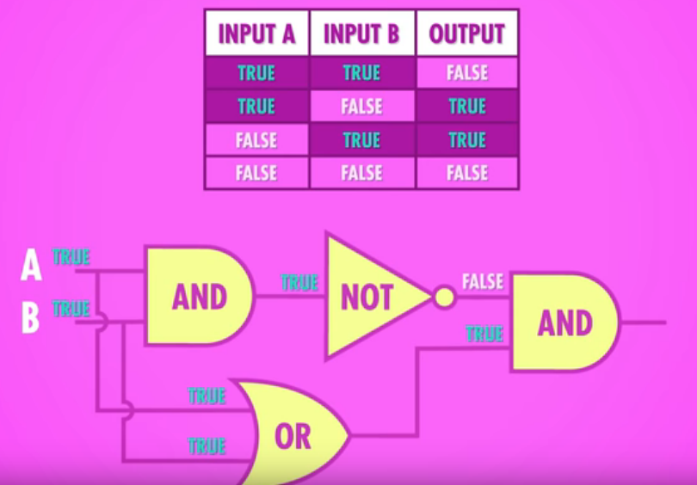
Binary
Other Operations from the previous ones
XOR

Slide 22
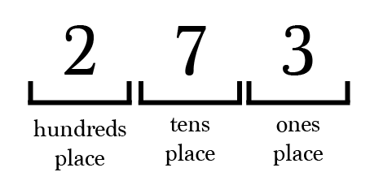
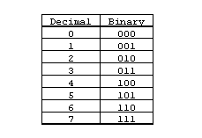
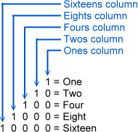
Binary
Number Representation
Decimal Notation System (Base 10)
Binary System (Base 2)

Slide 23

Binary
8 bit numbers == Byte
Values from 0 to 255
That’s 256 different values or 2^8
8 bit computers / 8 bit audio / 8 bit graphics
8 bit colours == 256 colours
24 bit colours == 16,777,216 colours
KiloByte (KB) = 1024 Bytes
MegaByte (MB) = 1024 KB
A million Bytes / 8 million bits
GigaByte (GB) = 1024 MB
A billion Bytes / 8 billion bits
TeraByte (TB) = 1024 GB
A trillion Bytes / 8 trillion bits
PetaByte ...

Slide 24
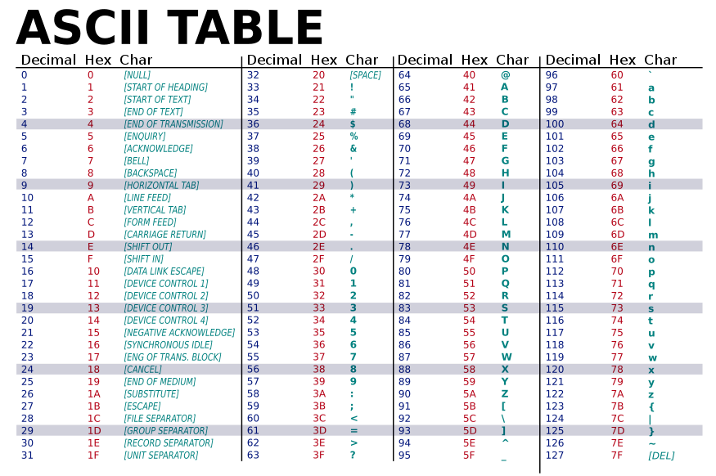
Words

Slide 25
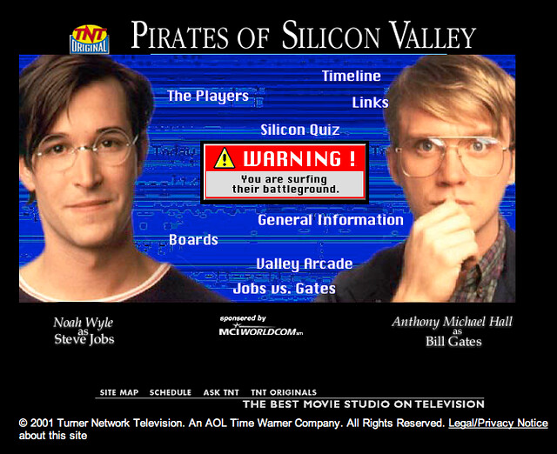
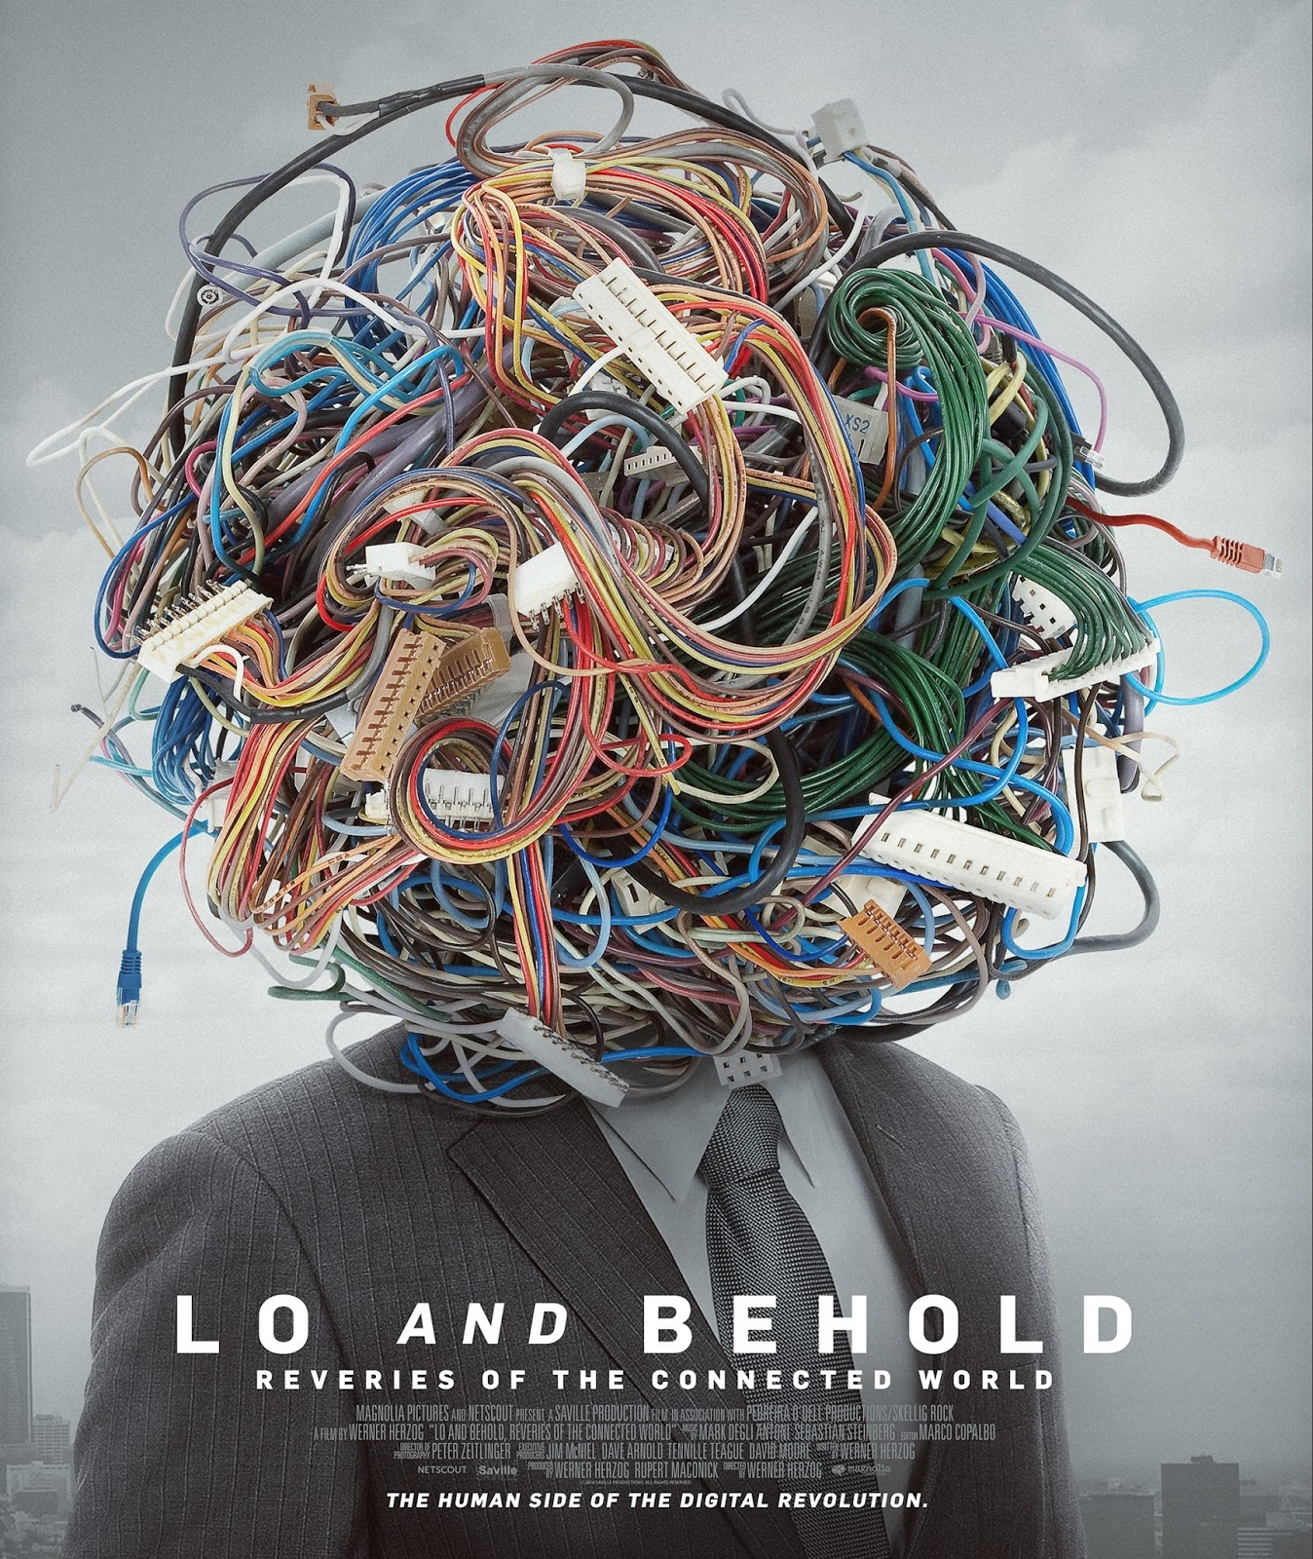
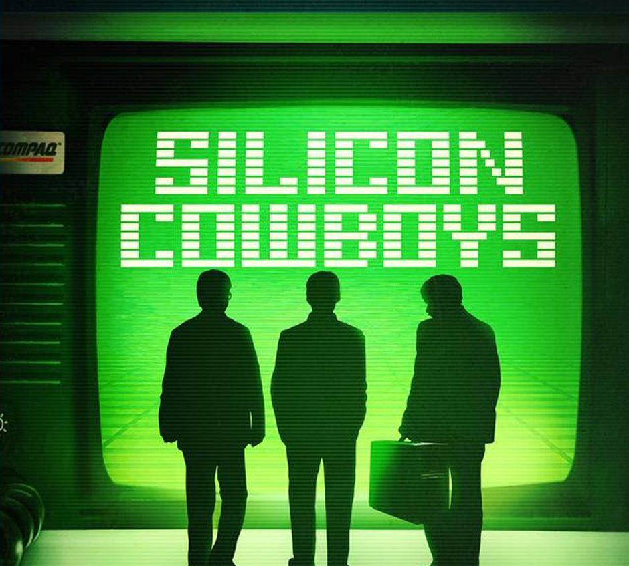
Some more movies to watch

Slide 26
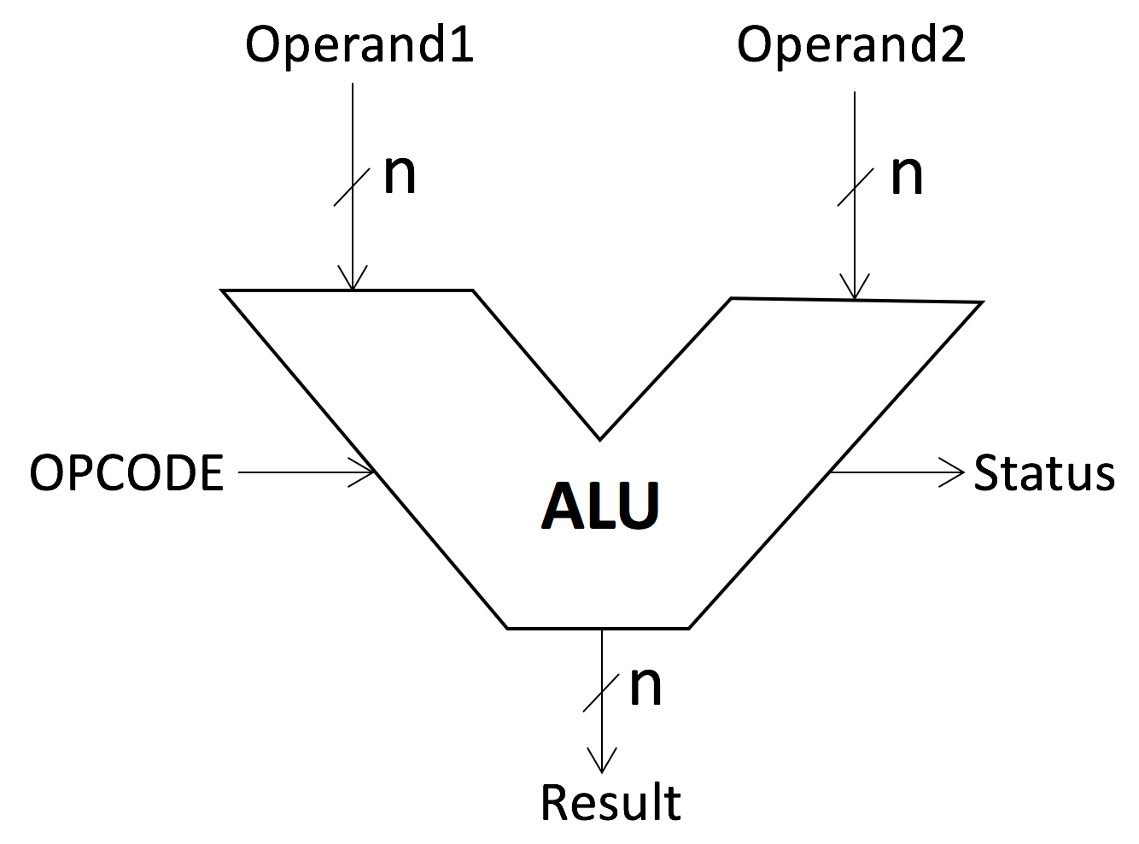
Parts of a computer
ALU (Arithmetic Logic Unit)
Mathematical heart of a computer

Slide 27
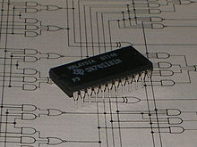
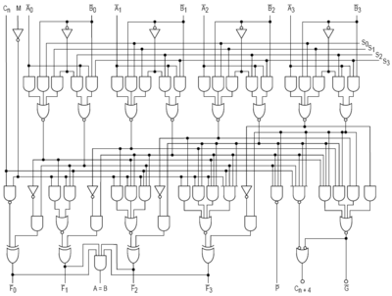
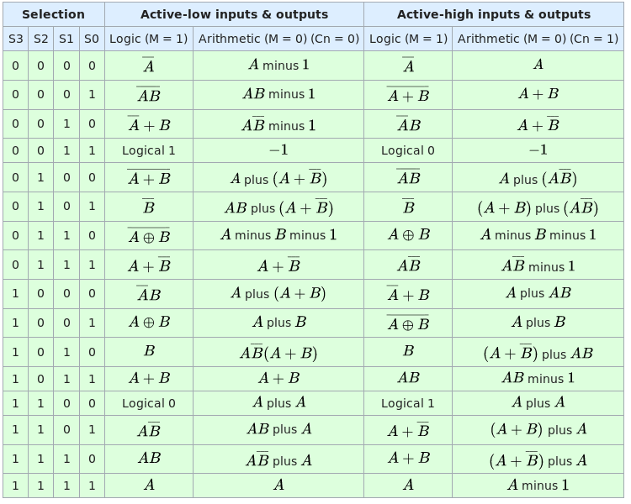
Parts of a computer
ALU
Intel 74181 (1970s)
First ALU that fit entirely in a single chip
4 bits ALU

Slide 28
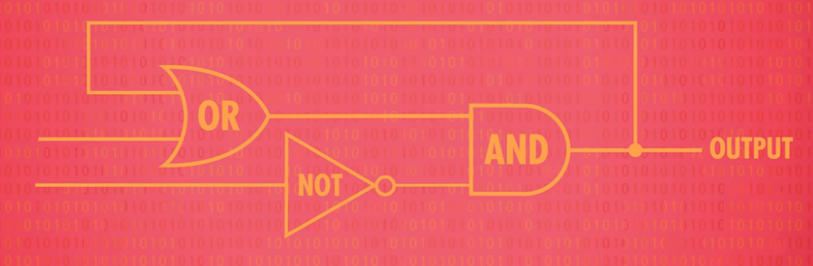
Parts of a computer
RAM (Random Access Memory)
AND OR LATCH

Slide 29
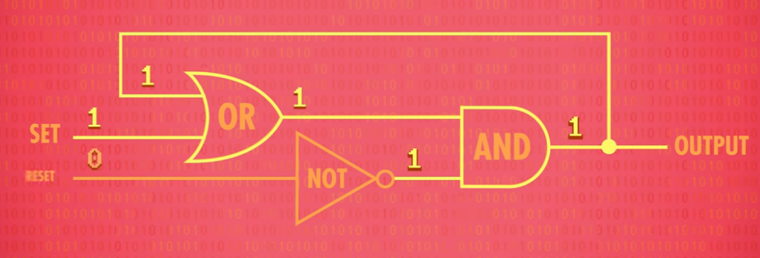
Parts of a computer
RAM (Random Access Memory)
AND OR LATCH
Set input to 1

Slide 30
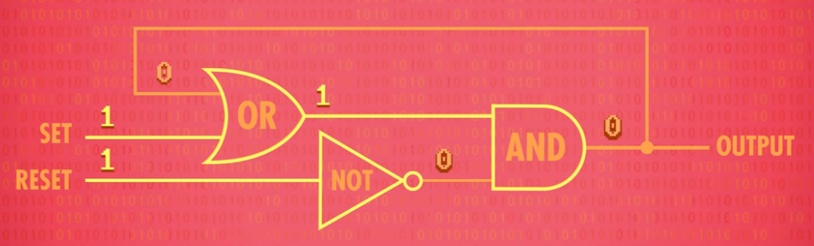
Parts of a computer
RAM (Random Access Memory)
AND OR LATCH
Rest sets back to 0

Slide 31
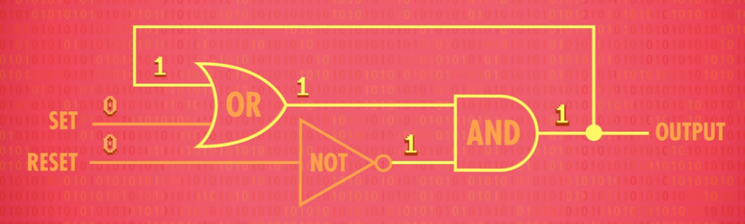
Parts of a computer
RAM (Random Access Memory)
AND OR LATCH
If both 0 maintain the last value

Slide 32
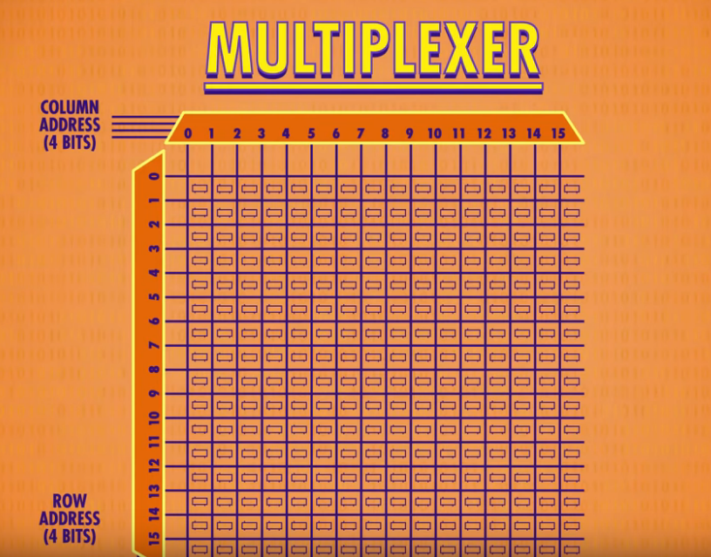
Parts of a computer
RAM (Random Access Memory)
With some more gates we can work with a single input
Adding flags for write enabled or not
A group of latches together is called a register
It holds a single number
We need to be able to access different registers
Address

Slide 33
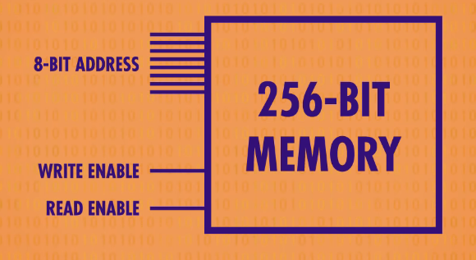
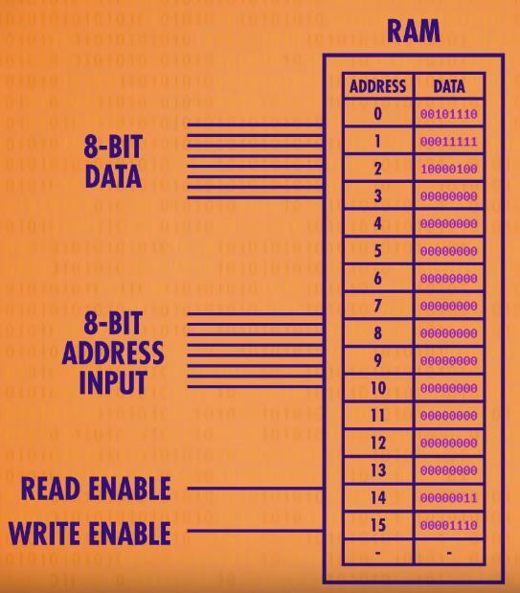
Parts of a computer
RAM (Random Access Memory)
Random Access
Order
We can access
any address
anytime

Slide 34
Parts of a computer
CPU (Central Processing Unit)
Computers execute programs
Programs made of hundreds of instructions
Arithmetic Instruction
CPU configures the ALU to perform the mathematical operation
Memory Instruction
CPU configures RAM to read/write address
CPU is the heart of the computer
Control Unit
Directs the operation of the processor
Reads input operation
Executes Operation
Return Value

Slide 35
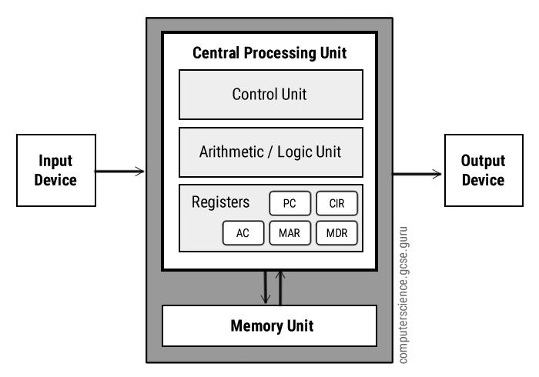
Parts of a computer
CPU (Central Processing Unit)

Slide 36
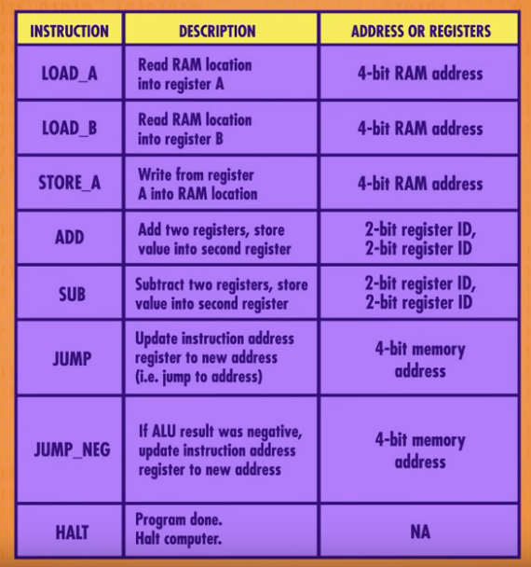
Parts of a computer
CPU (Central Processing Unit)
Programmable hardware by software instructions that allows to execute different instructions for a program

Slide 37
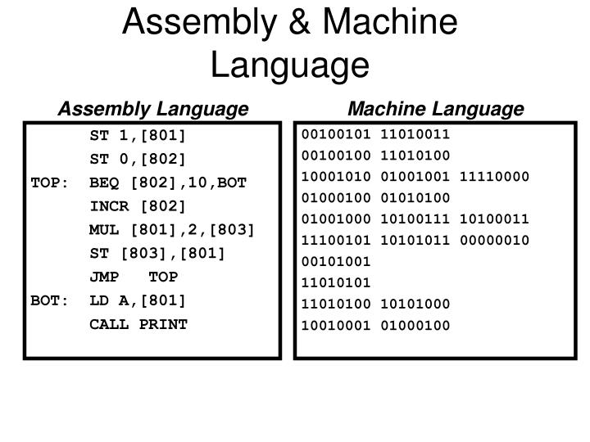
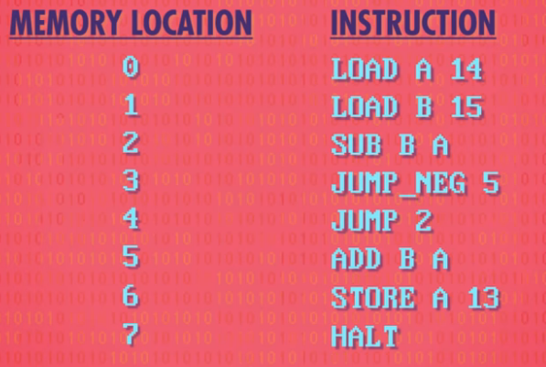
Programming
Machine Language vs Assembly Language

Slide 38
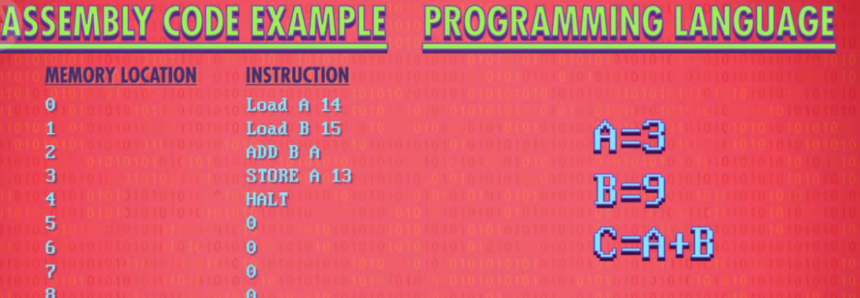
Programming
Compiler translates a higher level language into a lower language
C compiler to Assembly Language and machine language

Slide 39


Slide 40


